Slide 1


托福听力5
金牌听力名师
大菁儿老师
2021.6.8

Slide 2
第四节课回顾： 十大考点——主旨+定义； 社会科学词汇串讲 考古学、心理学文章及菁讲精练

Slide 3
十大考点——例子+强调；
自然科学词汇串讲
天文学+地理学文章及菁讲精练

Slide 4
考点三：记例子
信号词：
for instance
Such as
As an example
Take example for
Say
Consider
Take
Namely
注意：例子容易拿分，是刚开始练习的重点。
例子前一句话没跟上，别灰心，友善的教授还会重复

Slide 5
例子题练习1
TPO5-L1 meme 2'27-3'15
longevity
fecundity
fidelity
replicator
alligator

Slide 6
练习
TPO5-L1 meme 笔记
success replicator: long~; fecu~;fide~
L: long enough ---copy+trans info
long---better
eg:alligator long in mem---10 yrs
star~~~

Slide 7
TPO5-L1 meme
4.What example does the professor give of a meme’s longevity?
A. A story has been changing since it first appeared in the 1930s.
B. A person remembers a story for many years.
C. A gene is passed on through many generations without changing.
D. A song quickly becomes popular all over the world.

Slide 8
例子题练习2
TPO5-L1 3'22-3'47
housefly
reproduce

Slide 9
练习
TPO5-L1 meme 笔记
eg: housefly lay eggs
copy 1000----多
twinkle~~~ pass along

Slide 10
TPO5-lecture1
5.What does the professor compare to a housefly laying many eggs?
A. A child learning many different ideas from his or her parents
B. Alligators reproducing in New York sewers
C. Different people remembering different versions of a story
D. A person singing the “Twinkle, twinkle” song many times

Slide 11
考点四 ：记强调
1. 重复，停顿，吐字清楚，大声=强调
2. 信号词：
Especially，indeed，certainly，interesting，important， fascinating，exciting
Just remember
And again；Special feature
One thing I should mention
Make/be sure to…； Most importantly…
3. 比较级和最高级是重点 er, est, more, most, mostly, first, last, majority, minority, above all…
4.一问一答：必考！问题没听清楚，答案必须听清楚
5.否定信息
6.特征：feature， character， characteristic， trait
7.目的：purpose，aim, want to, goal, objective

Slide 12
强调练习1
TPO6-L1 boom and bust 1.51-2.02
unheard
novelty
bulb
roast
onion

Slide 13
For the Europeans, tulips were totally unheard of. Er…a great novelty. The first bulb to show up in the Netherlands, the merchant who received them roasted and ate them. He thought they were kind of onion.
4.Why does the professor mention a merchant who ate tulip bulbs?
A. to explain how the Turks introduce the flower to European visitors.
B. to explain what happened to tulip bulbs that did not produce desirable colors.
C. to give an example of one way that the rich in the Netherlands showed off their wealth.
D. to illustrate her point that Europeans were unfamiliar with the flower.

Slide 14
强调练习2
TPO10-L4 childhood amnesia
1.06-1'34
repressed
disturbing

Slide 15
Well, once a popular explanation was that childhood memories are repressed… um, the memories are disturbing, so that as adults we keep them buried. And so we can’t recall them… and this is based on… well—well it’s not based on–on–on the the kind of solid research and lab testing I want to talk about today, so—so let’s put that explanation aside and concentrate on just two. OK.
3.What does the professor imply about some of the explanations for childhood amnesia that she describes?
A. They can never be proved or disproved.
B. They were formed without proper evidence.
C. They explain only certain types of childhood amnesia.
D. They are contradicted by her own research.

Slide 16
天文学场景词汇
aerospace ['ɛrospes] n.航空与航天空间，宇宙空间；航空航天学
adj.宇宙航行的
astronaut [ˈæstrənɔ:t] n.宇航员
astronomer [ə'strɑnəmɚ] n.天文学家
astronomy [əˈstrɔnəmi] n.天文学
ambient ['æmbiənt] adj.周围的
crater ['kretɚ] n.火山口；陨石坑
diameter [daiˈæmitə] n.直径
eclipse [ɪˈklɪps] n. (日、月) 食
electromagnetic [ɪ,lɛktromæɡ'nɛtɪk] adj.电磁的
elliptical [ɪ'lɪptɪkl] adj.椭圆的；省略的
emit [ɪ'mɪt] vt.发出，放射

Slide 17
天文学场景词汇
epicycle ['ɛpə,saɪkl] n.[天]本轮；[数]周转圆
exploration [,ɛksplə'reʃən] n.探测，勘探
gauge [gedʒ] n.计量器
geocentric [,dʒio'sɛntrɪk] adj.以地球为中心的,由地球中心所见或测量的
geomagnetic [,dʒiomæg'nɛtɪk] adj.地磁的；地磁气的
gravitational [,grævɪ'teʃənl] adj.引力的
gravity ['ɡrævəti] n.万有引力; 地心引力
heliacal [hɪ'laɪək(ə)l] adj.太阳的；与太阳同时升落的
heliocentric [,hilɪə'sɛntrɪk] adj.以太阳为中心的
illuminate [ɪ'lumɪnet] vi.照亮
lopsided [,lɑp'saɪdɪd] adj.不平衡的，倾向一方的
luminosity [ˌluːmɪˈnɒsəti] n.光；发光体
magnetic [mæg'nɛtɪk] adj.地磁的；有磁性的；有吸引力的
object ['ɑbdʒɛkt] n.物体
optical ['ɑptɪkl] adj.光(学)的
orbit ['ɔrbɪt] vi/vt.盘旋；绕轨道运行; n.轨道
orient [ 'ɔ:rient] v.确定方向

Slide 18
天文学场景词汇
parabolic-orbit [,pærə’bɒlɪk] - n.抛物线运行
paradox ['pærədɒks] n.悖论，似是而非的观点
pattern ['pætə(r)n] n.图案, 图样
periodic-orbit [,pɪrɪ'ɑdɪk] - n.绕轨道周期运行
phase [fez] n.阶段, 时期 (月亮、行星的)位相
prism [prism] n.棱镜; 棱晶
radiation [,redɪ'eʃən] n.放射, 辐射; 发射; 发光
radio astronomy ['redɪo] [ə'strɑnəmi] [天] 射电天文学
radio wave 无线电波
reference point ['ref(ə)r(ə)ns][pɒɪnt] 参照点
remnant [ˈremnənt] adj.剩余部分；残余
revolve [rɪ'vɔlv] v.(使)旋转
rocket [ˈrɒkɪt] n.火箭；火箭发射器
rotate ['rotet] v.转动；交替；自转
satellite [ˈsætəlaɪt] n.人造卫星
scatter ['skætɚ] vi.分散，散开

Slide 19
天文学场景词汇
diffuse [dɪ'fjus] adj.弥漫的；散开的；v. 扩散；传播；漫射；vi.
传播；四散
sea horizon [siː][hə'raɪz(ə)n] 海平线
solar ['solɚ] adj.太阳的；日光的
space shuttle [spes] ['ʃʌtl] 航天飞机
spacecraft ['speskræft] n.宇宙飞船；航天器
stationary ['steʃənɛri］ adj.不动的; 静止的
sunspot ['sʌn,spɑt] n.太阳黑子；雀斑
symmetrically [sə'mɛtrɪkli] adv.对称地
telescope ['tɛlɪskop] n.望远镜
observatory [əb'zɝvətɔri] n.天文台；气象台
terrestrial [tə'restrɪəl] adj.陆生的
visible light ['vɪzəbl] [光]可见光
axial tilt ['æksɪəl] [tɪlt] n.轴倾角
launch [lɔ:ntʃ] v.发射；发动；开展
velocity [vəˈlɒsəti] n.速率，速度
impact ['impækt, im'pækt] n.碰撞；冲击力; vt.撞击；冲突
sphere [sfɪr] n.球体
treatise [‘tritɪs] n.论述；专著
ultraviolet [,ʌltrə'vaɪələt] adj.紫外线的

Slide 20
天文学精讲精练：
TPO18-lecture1太阳黑子 sunspot
flaw and blemishes
Galileo
lopsided
a lot of hypotheses were tossed around
geomagnetic activity

Slide 21
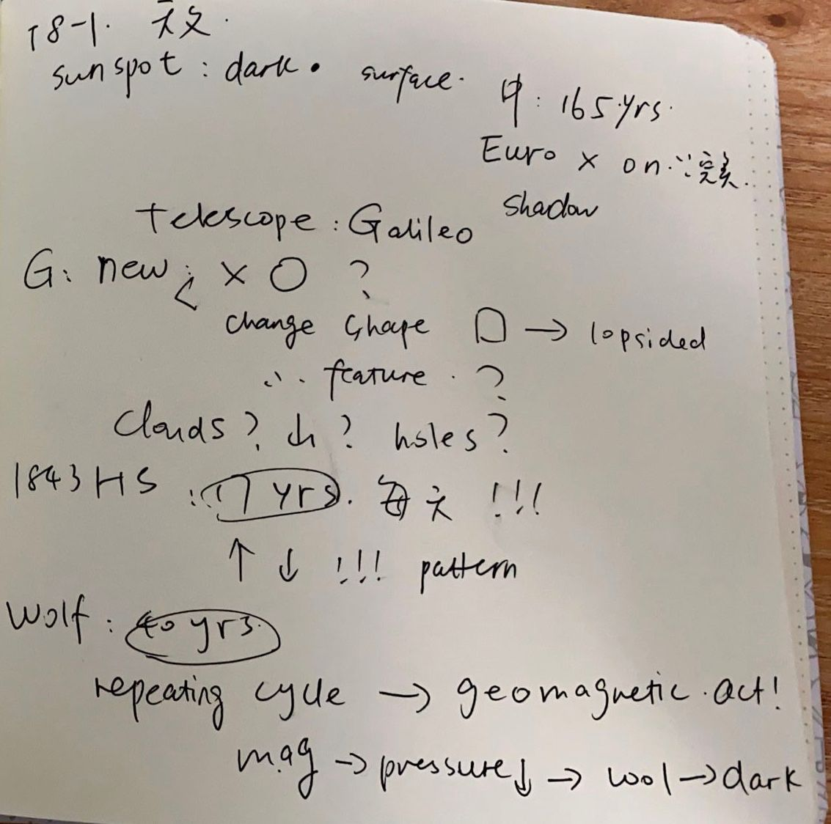
TPO18-lecture1
笔记

Slide 22
TPO18-lecture1
What is the lecture mainly about?
A.The importance of record keeping in the development of hypotheses
B. The relationship between sunspots and Earth's geomagnetic cycle
C. The progression of scientific knowledge about sunspots
D. The effect of sunspots on Earth's climate

Slide 23
TPO18-lecture1
Why did European astronomers before the time of Galileo not believe sunspots were on the Sun's surface?
A. They based their beliefs on earlier observations by Chinese astronomers
B. The idea was contrary to their beliefs about objects in space.
C. The sunspots often changed their shape.
D. The sunspots were not always visible.

Slide 24
TPO18-lecture1
Which hypothesis regarding sunspots did Galilee Challenge?
A. Sunspots are shadows of planets trussing the Sun
B. Sunspots are cloud in the solar atmosphere.
C. Sunspots are evidence of the Sun's rotation.
D. Sunspots are evidence of magnetic fields.

Slide 25
TPO18-lecture1
What was the importance of Schwabe's observation?
A. They determined the age of sunspots.
B. They established that sunspots appear in cycles.
C. They proved that sunspots were actually on the Sun.
D. They showed the reason that sunspots change their shape

Slide 26
TPO18-lecture1
What is the professor’s attitude toward Schwabe's and Wolf's research?
A. He is surprised that the research is contradictory.
B. He is impressed by how many years were spent on the research.
C. He has difficulty believing that research should take so long.
D. He doubts that the research is given enough credit by modern astronomers

Slide 27
TPO18-lecture1
Why does the professor imply about the discovery of a relationship between the sunspot cycle and Earth's geomagnetic cycle?
A. It proved that Gallieo's cloud hypothesis was correct.
B. It showed how conditions on Earth can affect the Sun.
C. It was the start of modern astronomy.
D. It led to a period of intense scientific research.

Slide 28
地质与地理词汇 Geology & Geography
glacial period ['ɡleʃl] ['pɪrɪəd] 冰河时代
Ice Age - 冰河时代
epoch [ˈepək] n.[地质]世; 新纪元，新时代
Antarctic [æn'tɑ:ktɪk] adj.南极的；n.南极洲
Arctic ['ɑrktɪk] adj.北级的；n.北极圈
pole [pol] n.极点
polar ['polɚ] adj.极地的；两极的
latitude ['lætɪtud] n.纬度
longitude ['lɑndʒətud] n.经度
equator [ɪ'kwetɚ] n.赤道
subtropical [,sʌb'trɑpɪkl] adj.亚热带的
tropical ['trɑpɪkl] adj.热带的
temperate zone ['tɛmpərət] - 温带
frigid zone ['frɪdʒɪd] - 寒带
merge [mɜ:dʒ] v.混合；相融；融入
slab pull [slæb] [pʊl] 板块拉力
spiral [ˈspaɪrəl] n.螺旋；漩涡
steep [sti:p] adj.陡峭的，险峻的

Slide 29
地质与地理词汇 Geology & Geography
subduction zone [səb'dʌkʃən] - 俯冲带，削减带
tectonic plate [tɛk'tɑnɪk] [plet] 地壳板块
tide [taɪd] n.潮汐
compression [kəmˈprɛʃən] n.压缩，浓缩；压榨，压迫
deformation [ˌdifɔrˈmeʃən,ˌdɛfə-] n.变形
lubricant [ˈlubrɪkənt] n.润滑剂
shatter [ˈʃætɚ] n.碎片
sliding ['slaɪdɪŋ] n.滑；移动 adj.变化的；滑行的
dynamic [daiˈnæmik] n.动态；动力，
evaporate [ɪˈvæpəˌret] vt.& vi.蒸发掉; 消失
filter [ˈfɪltɚ] vi.过滤；透过；渗透
impetus [ˈɪmpɪtəs] n.动力
perimeter [pəˈrɪmɪtɚ] n.<数>周长；周围，边界
deforestation [,di,fɔrɪ'steʃən] n.森林采伐
deposit [dɪ'pɒzɪt] n.沉积物
dormant ['dɔ:mənt] n.休眠
glacier ['ɡleʃɚ] n.冰河，冰川

Slide 30
练习：
TPO4-lecture3移动的石头
machinary
bulldozer
dominent
windstorm
meteorology
wilderness

Slide 31
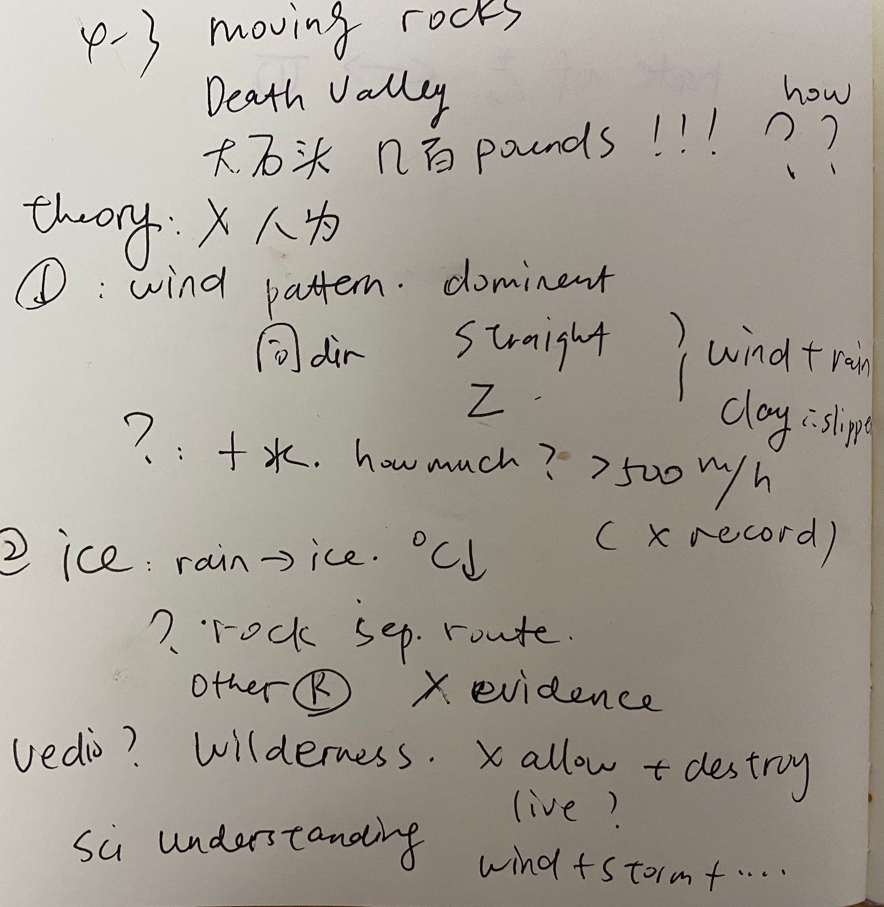
TPO4-lecture3
笔记

Slide 32
TPO4-lecture 3
What does the professor mainly discuss?
A. His plans for research involving moving rocks.
B. A difference between two geological forces that cause rocks to move.
C. Theories about why desert rocks move.
D. Reasons why geologists should study moving rocks.

Slide 33
TPO4-lecture 3
According to the professor, what have the researchers agreed on?
A. The rocks cannot move after ice storms.
B. The rocks do not move at night.
C. The rocks never move in circles.
D. The rocks are not moved by people.

Slide 34
TPO4-lecture 3
The professor mentions experiments on the wind speed necessary to move rocks. What is the professor’s attitude toward the experiments?
A. Their results were decisive.
B. They were not carried out carefully.
C. They were not continued long enough to reach a conclusion.
D. The government should not have allowed the experiments.

Slide 35
TPO4-lecture 3
9. What important point does the professor make about the area where the rocks are found?
A. It has been the site of Earth’s highest wind speeds.
B. It is subject to laws that restrict experimentation.
C. It is accessible to heavy machinery.
D. It is not subject to significant changes in temperature.

Slide 36
TPO4-lecture 3
10. What is the professor’s purpose in telling the students about moving rocks?
A. To teach a lesson about the structure of solid matter.
B. To share a recent advance in geology.
C. To give an example of how ice can move rocks.
D. To show how geologists need to combine information from several fields.

Slide 37
TPO4-lecture 3
11. Replay: What does the professor imply when he says this:
A. The movement pattern of the rocks was misreported by researchers.
B. The rocks are probably being moved by people.
C. The movement pattern of the rocks does not support the wind theory.
D. There must be differences in the rocks’ composition.

Slide 38
课后作业：
1. 回顾本次课内容，完成天文学+地质学单词记忆内容
2. 完成TPO54-4；53-4；42-2；
50-4；39-1；49-1的所有lecture题目
3. 预习第六次课中生态学+动物词汇
题目群里打卡

Slide 39

【✨课程福利✨】
1. 微博打卡：#考虫托福系统班#+天数+收获+图片+@考虫托福 @相应科目的老师 @酵母菁
（1）每周一抽取2个上周连续打卡的虫子送抱枕
2. 听课评论，听课后点击右上角【评论】按钮，说说虫子们对课程的想法和感受，课程结束后抽2个考虫T恤喔！

Slide 40
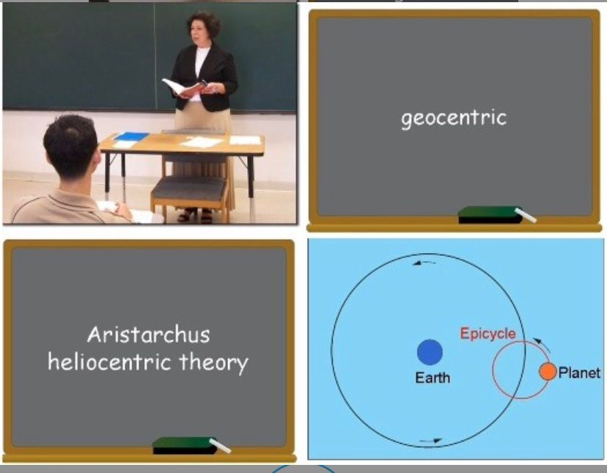
综合练习：
TPO21-L1

Slide 41
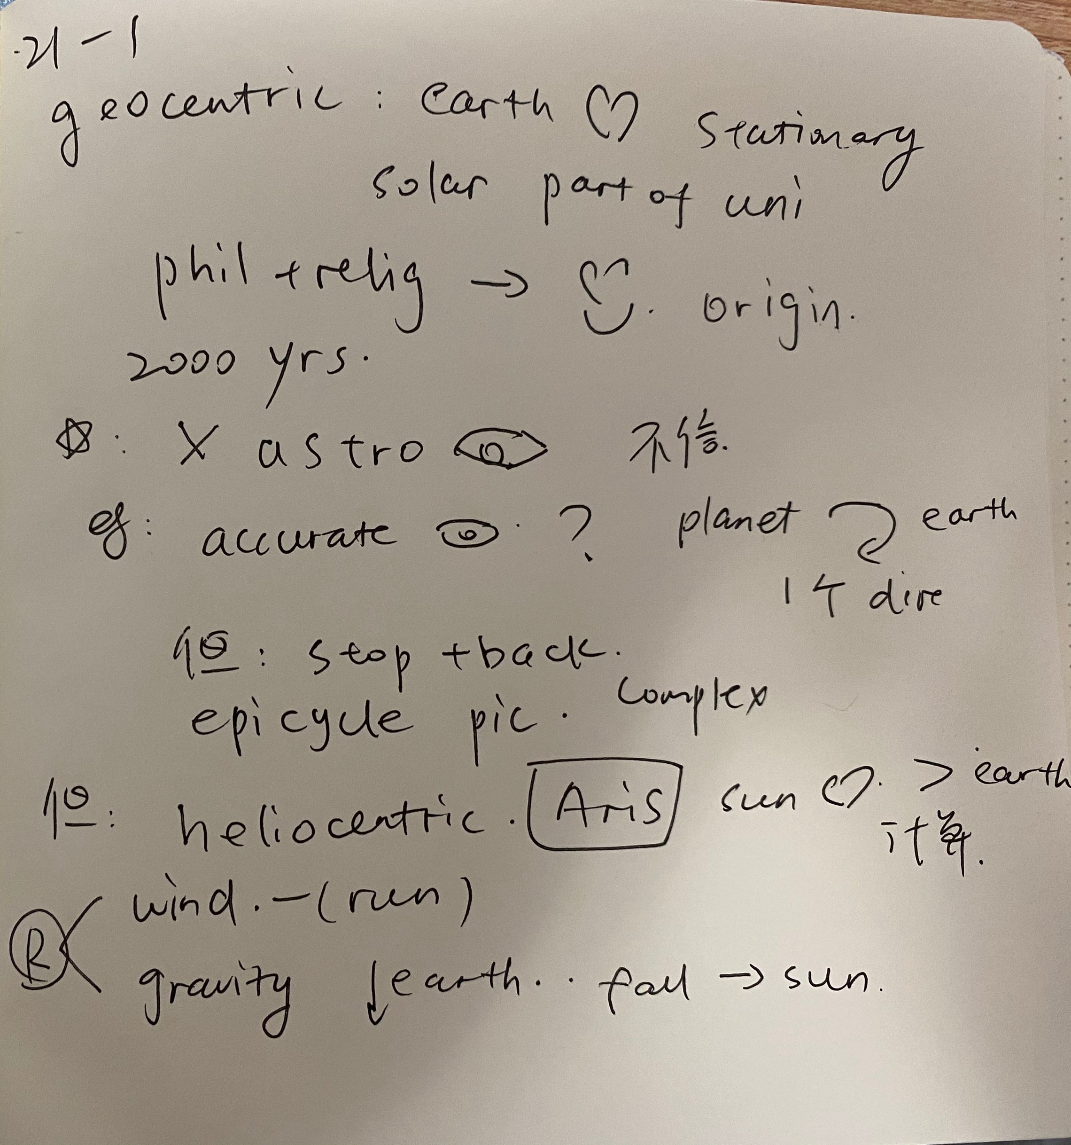
综合练习：
TPO21-L1

Slide 42
End

